Slide 1
課程內容
上課15次、期中1次、期末考1次、加分小考1次
第1週 2020/09/15 (二) Introduction to C
第2週 2020/09/22 (二) Introduce the C language and Print function
第3週 2020/09/29 (二) Logic Operator and Selection
第4週 2020/10/06 (二) Repetition Structure
第5週 2020/10/13 (二) Array and String
第6週 2020/10/20 (二) File IO
第7週 2020/10/27 (二) Functions
第8週 2020/11/03 (二) mid-term exam
第9週 2020/11/10 (二) Recursive Function
第10週 2020/11/17 (二) Pointer and Reference I
第11週 2020/11/24 (二) Pointer and Reference II
第12週 2020/12/01 (二) Structures
第13週 2020/12/08 (二) Dynamic Memory Allocation
第14週 2020/12/15 (二) Unions and Enumerations
第15週 2020/12/22 (二) final exam
第16週 2020/12/29 (二) Python Basic I
第17週 2021/01/05 (二) Python Basic II
第18週 2021/01/12 (二) Python extra quiz

Slide 2
計算機概論實習
Week II(2020/09/22)
Introduce the C language and Print function
Lab: EC 118
助教:
陳作源 russchen.cs08g@nctu.edu.tw
陳彥銨 my91015.cs08g@nctu.edu.tw
鄭智仁 king601012003.cs08g@nctu.edu.tw

Slide 3
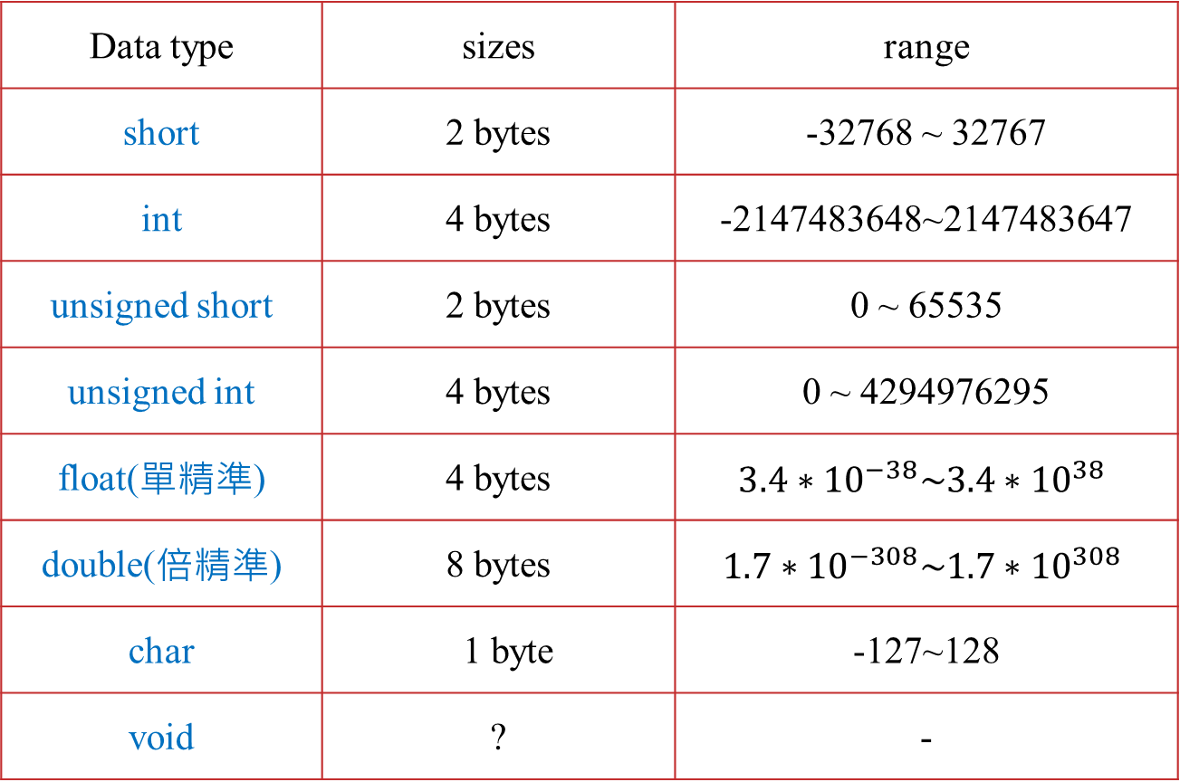
Data Type
Data type | sizes | range
short | 2 bytes | -32768 ~ 32767
int | 4 bytes | -2147483648~2147483647
unsigned short | 2 bytes | 0 ~ 65535
unsigned int | 4 bytes | 0 ~ 4294976295
float(單精準) | 4 bytes | $${3.4∗10}^{−38}\sim {3.4∗10}^{38}$$
double(倍精準) | 8 bytes | $${1.7∗10}^{−308}\sim {1.7∗10}^{308}$$
char | 1 byte | -127~128
void | ? | -
Note : You can use the function sizeof() to print the size

Slide 4
Variable
int integer
int a = 9;
int a; a=9;
float floating point
float b = 8.1;
double floating point (more precise)
double c = 5.3;
char character
char d = ‘A’;

Slide 5
Name of Variable
Composed of letters, digits, and the underscore character
E.g. *&^% is not allowed
Can not use reserved words
E.g. int、float、char
Meaningful is better
int NumberOfUserA
Can not begin with Chinese
E.g. int 年齡
Can not begin with a digit
E.g. int 1NumberOfUserA

Slide 6
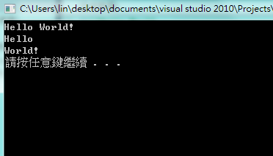
printf
printf：Print formatted data to stdout.
Format：printf(“ ”);
E.g.：printf(“Hello World! \n”);
Ouput : Hello World.
E.g.：printf(“Hello\nWorld. \n”);
Ouput : Hello
World!

Slide 7
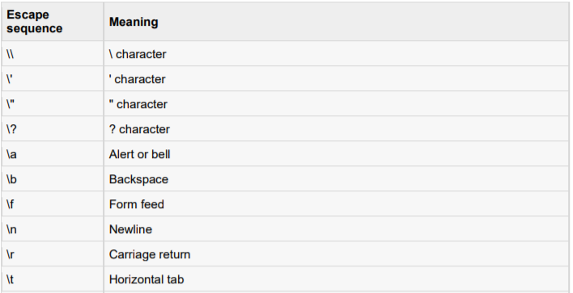
printf
\n 相當於打字時按Enter鍵
\t 相當於打字時按Tab鍵
“ ” 符號中可以包含空白字元( )、符號(*.+-?等)、字元(ABC一二三等)

Slide 8
Print integers in different representation
例：int num_1=65;
printf(“%d”, num_1);
Output : 65 // %d output in decimal
printf(“%o”, num_1);
Output : 101 // %o output in octal
printf(“%x”, num_1);
Output : 41 // %x output in Hexadecimal
printf(“%c”, num_1);
Output : A // %c output in character
//(ASCII : https://zh.wikipedia.org/wiki/ASCII)

Slide 9
Print the floating point
float num_2 = 5.234;
printf(“%f”,num_2);
印出 5.234000 // %f Output floating point to the sixth
decimal place
printf(“%.2f,num_2”);
印出 5.23 // %.2f Output floating point to the second
decimal place

Slide 10
其他Output format.
%c | 以字元⽅式輸出
%d | decimal
%o | octal
%u | Unsinged integer
%x, %X | Hexadecimal
%f | Floating point
%e, %E | Floating point in Scientific notation
%g, %G | Floating point， %f or %e, use the simple ones
%% | output %
%s | string
%lu | long unsigned integer
%p | pointer

Slide 11
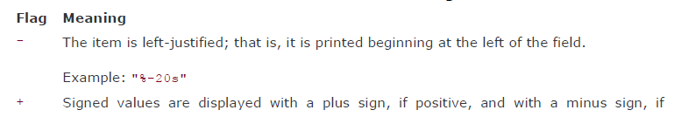

Printf() Flags

Slide 12
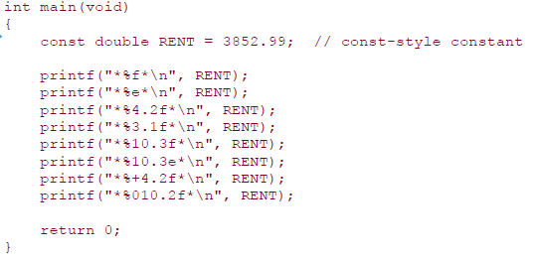
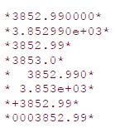
Printf() Flags

Slide 13
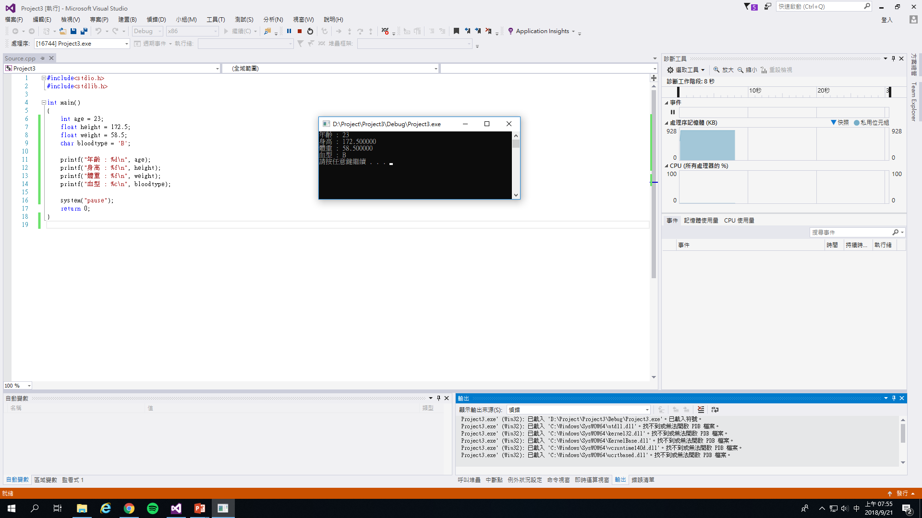
Example

Slide 14
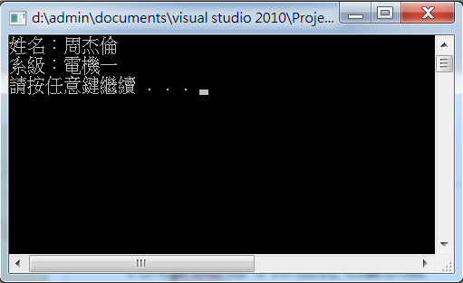
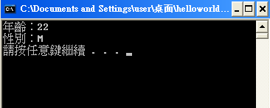
Exercise
Exercise1
Use printf() to print your department
and grade.
Exercise2
Print your age and gender (Male:M Female:F)
You should declared variables before you using printf()

Slide 15
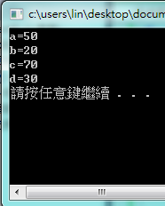
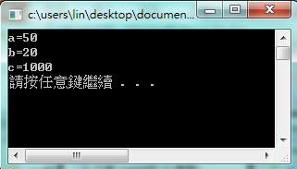
Arithmetic Operators
Add and subtract
int a,b; // declared integer variables a, b
int c,d; // declared integer variables c, d
a=50;
b=20;
c=a+b; //add a and b, then assign to c
d=a-b; //subtract a and b ，then assign to d
multiplication
int a,b;
int c;
a=50;
b=20;
c=a*b; //multiply a and b ，then assign to c

Slide 16
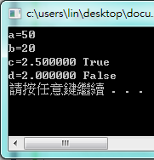
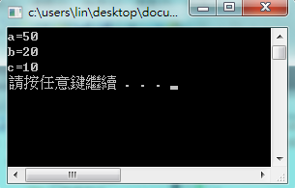
Arithmetic Operators
Division
int a,b; // declared integer variables a, b
float c,d; // declared floating point variables c
a=50;
b=20;
c=(float)a/b; // divide a by b , then assign to c
d=a/b; // divide a by b , then assign to d
When we do division, data type is very important
Take the remainder %
int a,b;
int c; a=50;
b=20;
c=a%b;

Slide 17

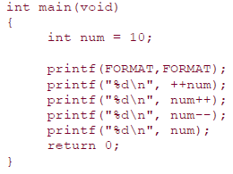
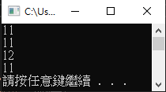
Arithmetic Operators

Slide 18
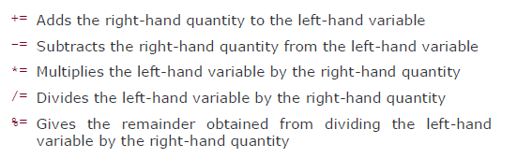
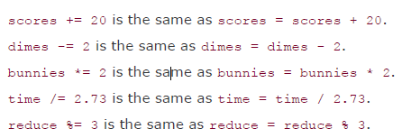
Assignment Operators

Slide 19
scanf
Reads input
Format
int a;
scanf(“%d”,&a);
Store the input integer into &a
&a：point to the memory address where variable a is stored

Slide 20
scanf
使用scanf函式前，需在最一開始加上
#define _CRT_SECURE_NO_WARNINGS
否則在用visual studio 2017 執行時，會有error產生。

Slide 21
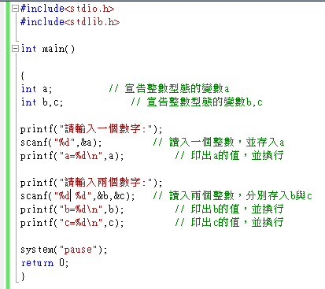
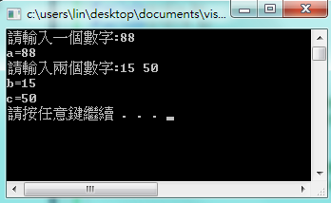
Example

Slide 22
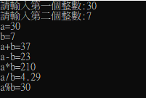
Exercise
Exercise 3
Use scanf to get two integers and do add, subtract, multiplication, division, and find the reminder.
Note : result of a/b need to be floating point to the second decimal place

Slide 23

Exercise
Exercise 4
Use scanf to read a positive integer — seconds，change it to ?days ?hours ?minutes ?seconds

Slide 24
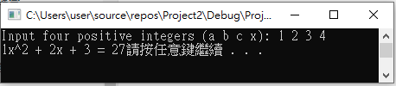

Exercise
Exercise 5
Use scanf to read 4 integers, a b c x, compute $ax^{2}+bx+c and print it$

